Slide 1

Tactile Navigation Support for Blind Individuals
by
K. Hemanth Reddy
Roll No. 214G5A0506
Department of Computer Science and Engineering
Srinivasa Ramanujan Institute of Technology
(Autonomous)
2023 - 2024

Slide 2

Contents
Abstract
Introduction
Proposed System
Planning & Design
Implementation
Results
Conclusion
Research Paper
References

Slide 3
Abstract
Sighted individuals possess the ability to navigate their surroundings with ease and utilize their visual facility to promptly identify potential hazards. Conversely, individuals who are visually impaired are unable to perceive the external environment, traverse independently, or discern danger. Moreover, they may occasionally feel distressed and wish to notify their family or friends of their location via text. So, the primary challenge faced by visually impaired individuals is their reliance on others, as even their closest relatives may not always be able to provide adequate care. To address this issue, a "Smart Stick" would be developed utilizing the "Internet of Things". Using a variety of sensors, including ultrasonic, soil moisture, RF, GPS-GSM modules and using Arduino UNO, the Smart Stick empowers blind people to be independent and gives them a sense of normalcy.
Keywords: Smart Stick, Ultrasonic Sensor, Soil Moisture, Solar Panel, Infrared Sensor, GPS-GMS Module, Relay Module, RF Module, User setup Notification.

Slide 4
Introduction
Blind persons always struggle with their daily tasks since they are unable to see even a single thing.
When using a standard blind stick, blind persons have trouble recognizing stairs and obstacles surrounded by them.
By making the use of smart blind stick, we can hear alert noises to identify stairs and obstacles.
The problem can be minimized using IoT technology.
The Internet of Things (IoT) describes the network of physical object that are embedded with sensors, software, and other technologies for the purpose of connecting and exchanging data with other devices and systems over the internet.
Sensors play an important role in creating solutions using IoT.
Sensors are devices that detect external information, replacing it with a signal that humans and machines can distinguish.
IoT = Sensing + Communicating + Computing

Slide 5
Proposed System
The proposed system is capable of detecting the surroundings for various barriers of different sizes and producing the required auditory using the ultrasonic sensor in the presence of buzzer. When damp surfaces are detected using sensors, it might alert the user by vibratory sounds and also enable to send SMS based on the user's location in an emergency or when they are having trouble. When the stick is misplaced, the user can find the stick by using an RF remote control.

Slide 6
Planning
Objective
To develop a model that will enable blind persons to navigate both familiar and unfamiliar places without the use of guides. To alarm the user through vibration to determine the obstacles direction sources.
To create a user-friendly interface that makes use of tactile feedback and sensations that are simple for blind users to grasp and interpret, enabling them to make independent.
Scope
Alert the blind people by giving buzzer when obstacle is detected.
Notify the blind people by giving vibration motor when wet surfaces are detected.
Alert the blind people by giving speaker when stairs are detected.

Slide 7
Planning
HARDWARE AND SOFTWARE REQUIREMENTS:
Hardware:
Arduino Uno
Ultrasonic Sensor
Moisture Sensor
Infrared Sensor
GSM Module
GPS Module
RF Module
Battery
Relay Module
Speaker
Buzzer
Vibration Motor
Push Button
Solar Panels

Slide 8
Planning
Software:
Arduino IDE
RAM: 4GB and Above
Memory: 8GB and Above
Processor: I3 and Above

Slide 9
Planning
Functional Requirements
To develop a prototype hardware for modern blind stick.
To help the blind people navigate the route at their best.
To reduce the risk of injuries and lost for the visually impaired person.
Non Functional Requirements
Reliability:
The smart blind stick should be ensuring that it operates consistently and accurately in various environments and conditions.
Portability:
The device should be easy to carry, ensuring that it is practical for daily use and travel.
Usability:
The smart blind stick should be user-friendly, with an intuitive interface and easy-to-understand controls.

Slide 10
Planning
Methodology
To implement this project Iterative model is used. It involves continuous cycle of Planning, Analysis, Implementation and Evaluation.
Each cycle produces a segment of development that forms the basis for the next cycle of iterative development.
Advantages:
It is easily acceptable to ever-changing needs of the project.
Testing and debugging during smaller iteration is easy.
A parallel development can plan.

Slide 11
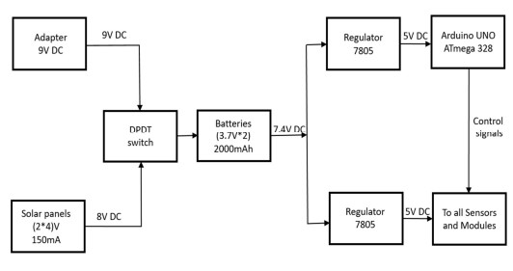
Design
System Architecture

Slide 12
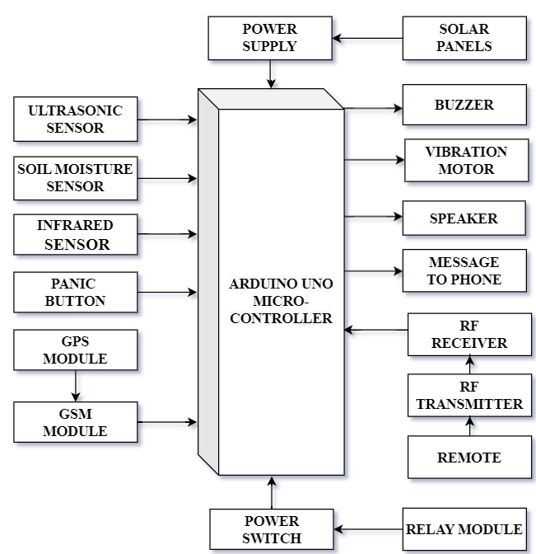
Design
Block Diagram

Slide 13
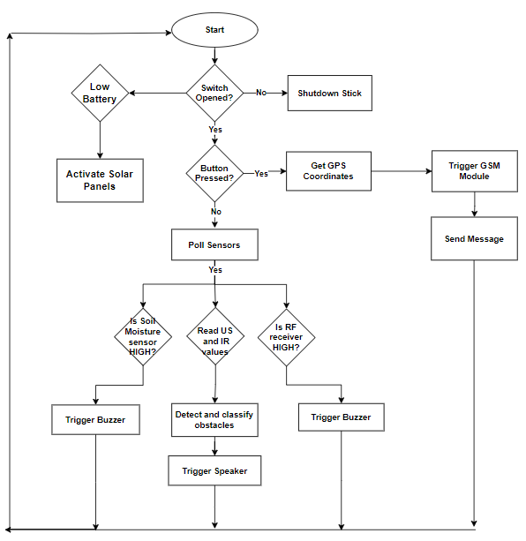
Design
Flow Chart

Slide 14
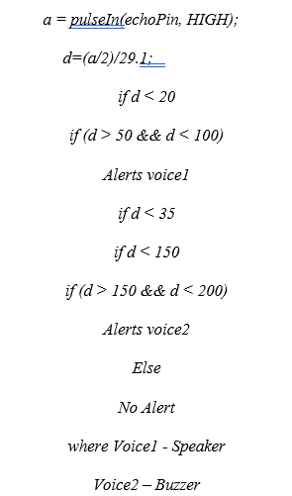
Implementation
Module 1: Object and Wet Surface Detection
The first module utilizes ultrasonic for object detection and soil moisture for wet surface. Alerts the user through a dual-alert mechanism, comprising a buzzer for auditory signals and a vibration mechanism for tactile feedback.

Slide 15

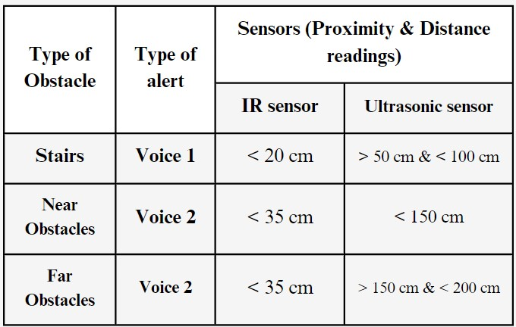
Implementation
Table-1 Classification of obstacles based on sensor readings

Slide 16
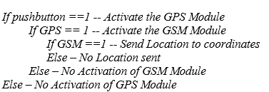
Implementation
Module 2: GSM and GPS Location Notification System
The second module incorporates GPS and GSM modules for accurate communication and position tracking. Actual-time location notifications are transmitted via push notifications to pre-specified mobile devices when user-initiated push button is pressed. Combines location-based communication with sophisticated environmental awareness to create absolute Smart Stick solution.

Slide 17

Implementation
Module 3: Remote Control
The third module designed with an RF module and a dedicated remotecontrol unit, this module introduces remote control capabilities for locating the stick. Users can remotely activate location alerts, adding a layer of convenience to the Smart Stick. Auditory feedback through a buzzer enhances the user experience during remote control interactions, making the system more user-friendly and accessible.

Slide 18
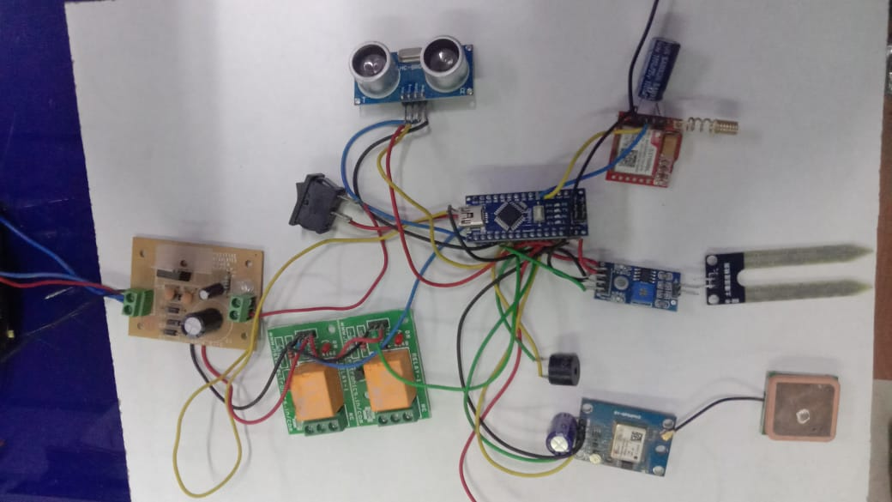
Implementation
Fig 1 Circuit Diagram

Slide 19
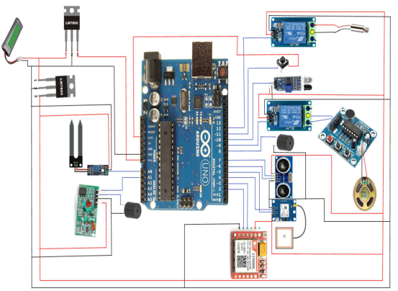
Results
Fig-2 Experimental Setup

Slide 20
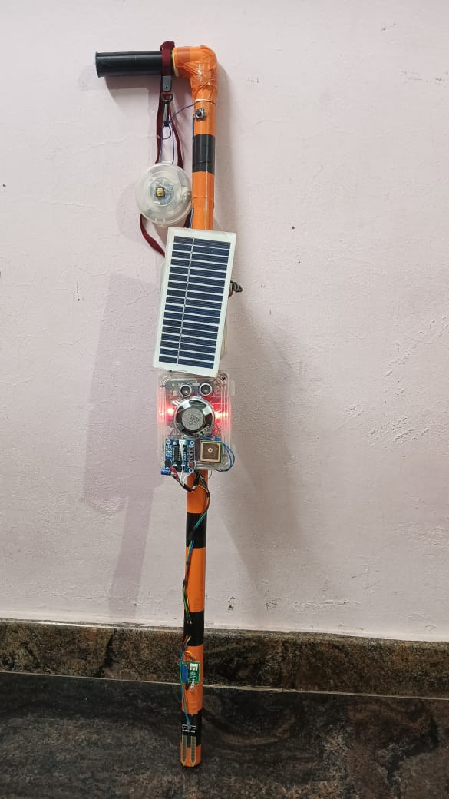
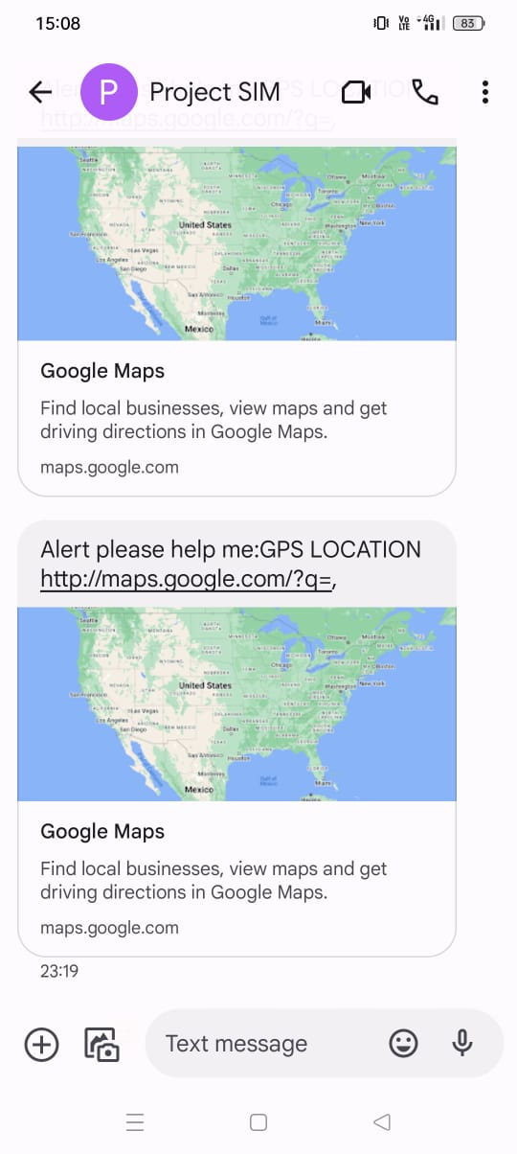
Results
Fig-3 Smart Blind Stick
Fig-4 Alert Messages to the Coordinates
of the Blind Person

Slide 21
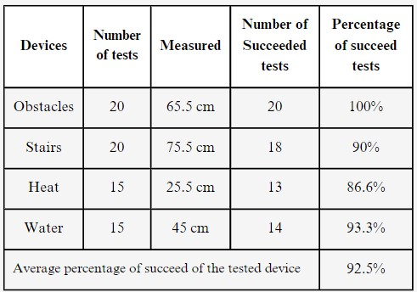
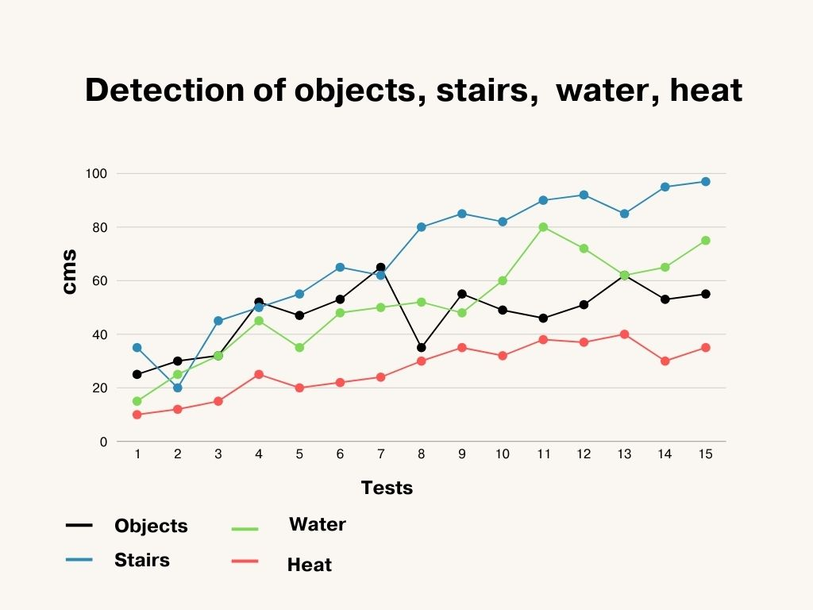
Results
Table-2 Tests of Smart Blind Stick
Fig-5 Detection of Objects, stairs, water, heat

Slide 22
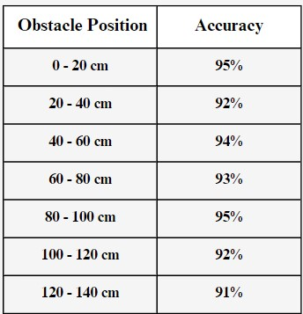
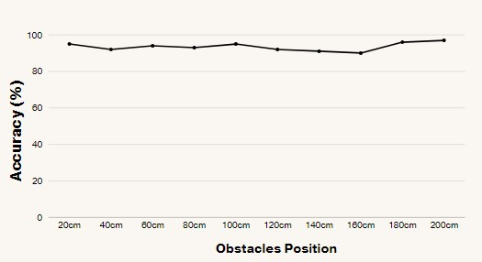
Results
Table-3 Reliability for obstacle position
Fig-6 Reliability for obstacle position

Slide 23
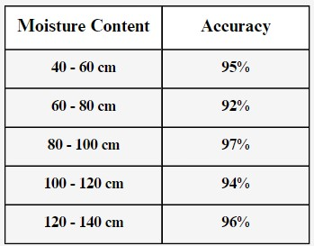
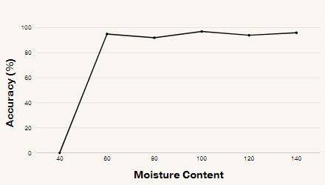
Results
Table-4 Reliability for moisture content
Fig-7 Reliability for moisture content

Slide 24
Conclusion
Finally, the proposed system effectively detects barriers using the ultrasonic sensor with auditory alerts and provides safety features such as vibratory alerts for damp surfaces and emergency SMS based on user location. The inclusion of an RF remote control for stick retrieval enhances user autonomy. The system offers a comprehensive solution for obstacle detection, emergency response, and stick location retrieval, making it valuable tool for individuals with visual impairment.

Slide 25
Research Paper
Research Paper

Slide 26
References
[1] Naiwrita Dey, Ankita Paul, Pritha Ghosh, Chandrama Mukherjee, Rahul De,“Ultrasonic Sensor Based Smart Blind Stick”, International Conference on Current Trends toward Converging Technologies, Coimbatore, India, 978-1-5386-3702-9/18 2018.
[2] Md.Adil, TaiyabaShadaka Rafa, Jannatul Ferdoush, Abir Mahmud, Abhijit Pathak, “An IoT based Voice Controlled Blind Stick to Guide Blind People”, International Journal of Engineering Inventions, Volume 9, Issue 1 Jan 2020.
[3] Somnath koley, Ravi Mishra, ”Voice operated outdoor navigation system for visually impaired persons”, International Journal of Engineering Trends and Technology- Volume 3, Issue2- 2012.
[4] Suraj Babhale, Pratiksha Bhagat, Nikhita Saharkar, Mayur Pillewan, Nikhil Rangari, V. N. Mahawadiwar, “Implementation of Smart Stick for Blind and Visually Impaired People using Arduino”, International Journal of Innovative Research in Science, Engineering and Technology, Volume 10, Issue 6, June 2021.
[5] M. Ghana Shyam, Shravankumar G M, Ashabee, Kodal Ashwini, Ravi Kumar H M, ”Blind guide stick using GPS and GSM module”, International Research Journal of Engineering and Technology Volume 7, Issue 6, June 2020.
[6] Ronak Panchal, Sneha Sankhe, Saad Khan, Vishal Singh, “Blind Stick for Visually Impaired People”, International Research Journal of Engineering and Technology Volume 8, Issue 5, May 2021.
[7] Mohd Helmy Abd Wahab, Amirul A. Talib, Herdawatie A. Kadir, Ayob Johari, A.Noraziah, Roslina M. Sidek, Ariffin A. Mutalib, “Smart Cane: Assistive Cane for Visually-impaired People”, International Journal of Computer Science Issues, Vol. 8, July 2011.

Slide 27
Thank You!!!

